Slide 1
Frequent Itemset Pattern & Apriori Principle
Srijana Bhusal (072/BEX/440)
Sunidhi Amatya (072/BEX/443)
Madhusudan Mainali (072/BEX/449)
Anil Kumar Sah (072/BEX/450)

Slide 2
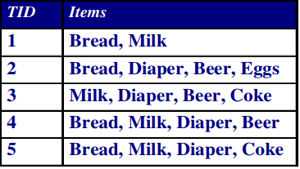
Frequent Itemsets
Itemset : A collection of one or more items
Example: {Milk, Bread, Diaper}
k-itemset : An itemset that contains k items
Support count (σ):Frequency of occurrence of
an itemset
E.g. σ({Milk, Bread,Diaper}) = 2
Support:Fraction of transactions that contain an itemset
E.g. s({Milk, Bread, Diaper}) = 2/5
Fig: Transactions of items

Slide 3
Support(s) = (Transactions containing (Milk, Bread, Diaper))/(Total Transactions)
Here,
s({Milk, Bread, Diaper}) = 2/5
Frequent pattern: a pattern (a set of items, subsequences, substructures, etc.) that occurs frequently in a data set

Slide 4
Confidence
Confidence refers to the likelihood that an item B is also bought if item A is bought. It can be calculated by finding the number of transactions where A and B are bought together, divided by total number of transactions where A is bought.
It is a conditional probability.
Mathematically, it can be represented as:
Confidence(A→B) = (Transactions containing both (A and B))/(Transactions containing A)

Slide 5
Candidate Generation & Test
Apriori property: Any subset of a frequent itemset must also be frequent
A transaction containing {milk, bread, diaper} also contains {milk, diaper}
{beer, diaper, bread} is frequent then,{beer, diaper} must also be frequent
In other words, any superset of an infrequent itemset must also be infrequent – No superset of any infrequent itemset should be generated or tested

Slide 6
Frequent Itemset: All the sets which contain the item with the minimum support (denoted by 𝐿𝑖 for 𝑖 𝑡ℎ itemset).
Join Operation: To find L k , a set of candidate k-itemsets is generated by joining Lk-1 with itself.
The Apriori Algorithm
Apriori Algorithm is one of the basic and famous approach used in mining frequent patterns.
Apriori uses a "bottom up" approach, where frequent subsets are extended one item at a time (a step known as candidate generation, and groups of candidates are tested against the data.

Slide 7
The Apriori Algorithm
Apriori is designed to operate on database containing transactions (for example, collections of items bought by customers, or details of a website frequentation).
There are three major components of Apriori algorithm:
Support
Confidence
Lift
Already talk about support and confidence

Slide 8
lift
Lift(A -> B) refers to the increase in the ratio of sale of B when A is sold. Lift(A –> B) can be calculated by dividing Confidence(A -> B) divided by Support(B)
Mathematcally,
Lift(A->B)=(confidence(A->B))/ )=(support(B))
Apriori-Pruning Principal
“If there is any item set which is infrequent, its superset should not be generated or tested.”
This simply means if A is infrequent we can avoid checking A,B as a frequent item set.

Slide 9
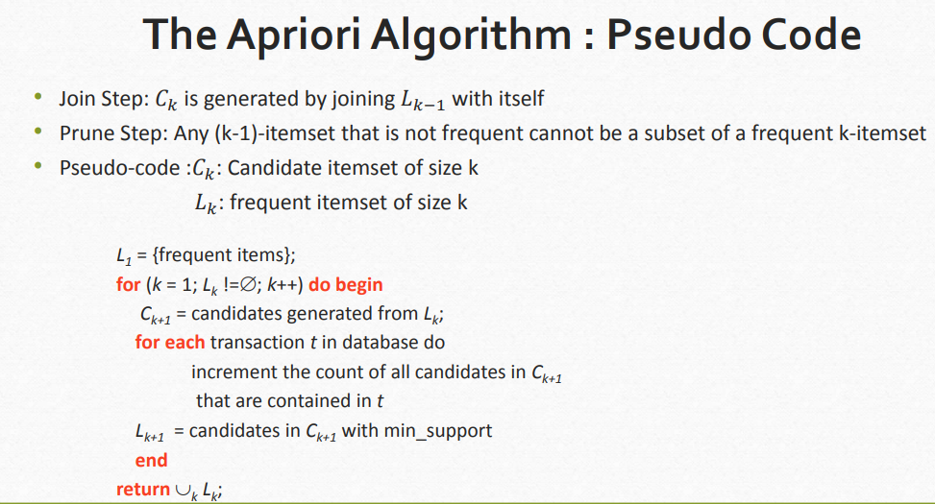

Slide 10
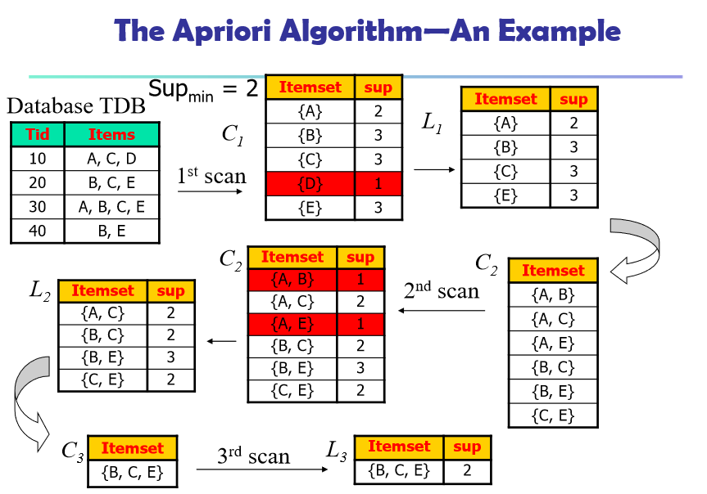

Slide 11
Generating Association Rules from Frequent Itemsets
Let minimum confidence threshold is , say 70%.
In previous example,We have ,L3={B,C,E}
• The resulting association rules are shown below, each listed with its confidence.
R1: B^C ->E
Confidence = s{B,C,E}/occurance of{B,C} = 2/2= 100% So,(R1 is SELECTED)
R2: B^E ->C
Confidence = s{B,C,E}/occurance of{B,E}=2/3=66.66%
R3: C^E ->B
Confidence = s{B,C,E}/occurance of{C,E}=2/2=100% so,(R3 is selected)

Slide 12
Similarly, we get
R4:B->C^E
Confidence = s{B,C,E}/occurance of{B}=2/3=66.66%
R5:C->B^E
Confidence = s{B,C,E}/occurance of{C}=2/3=66.66%
R5:E->B^C
Confidence = s{B,C,E}/occurance of{E}=2/3=66.66%

Slide 13
LIMITATIONS
Apriori algorithm can be very slow and the bottleneck is candidate generation.
For example,
if the transaction DB has 10^4 frequent 1-itemsets, they will generate 10^7 candidate 2-itemsets even after employing the downward closure.
To compute those with sup more than min sup, the database need to be scanned at every level. It needs (n +1 ) scans, where n is the length of the longest pattern.

Slide 14
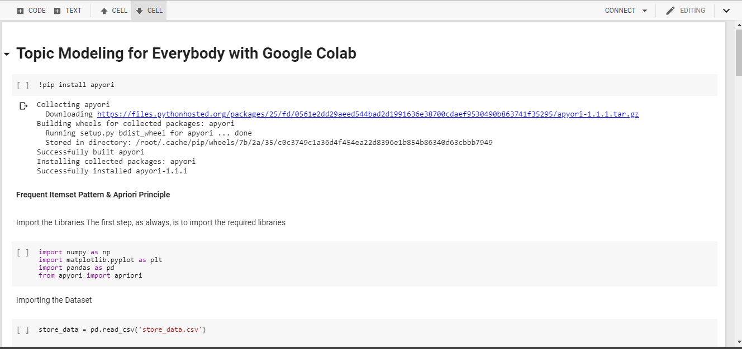

Slide 15
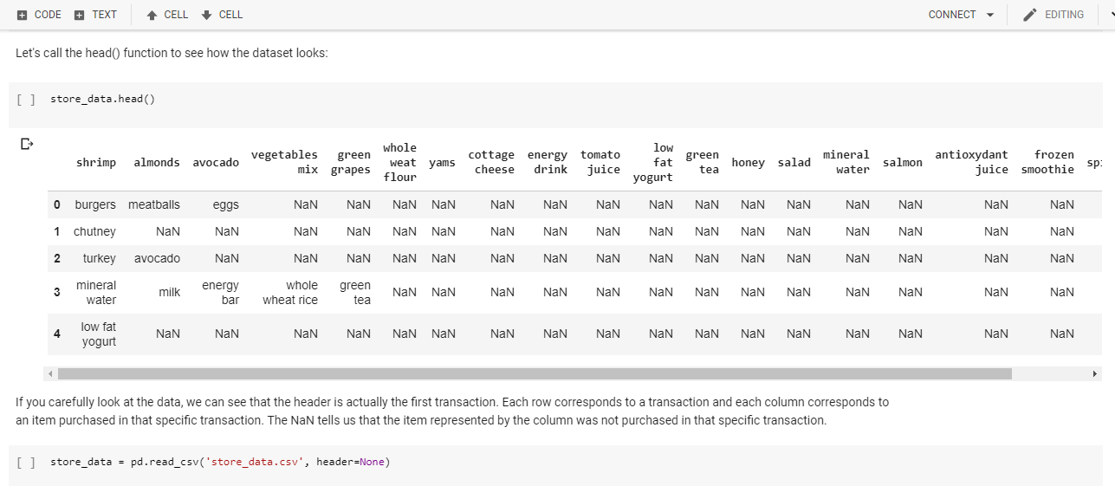

Slide 16
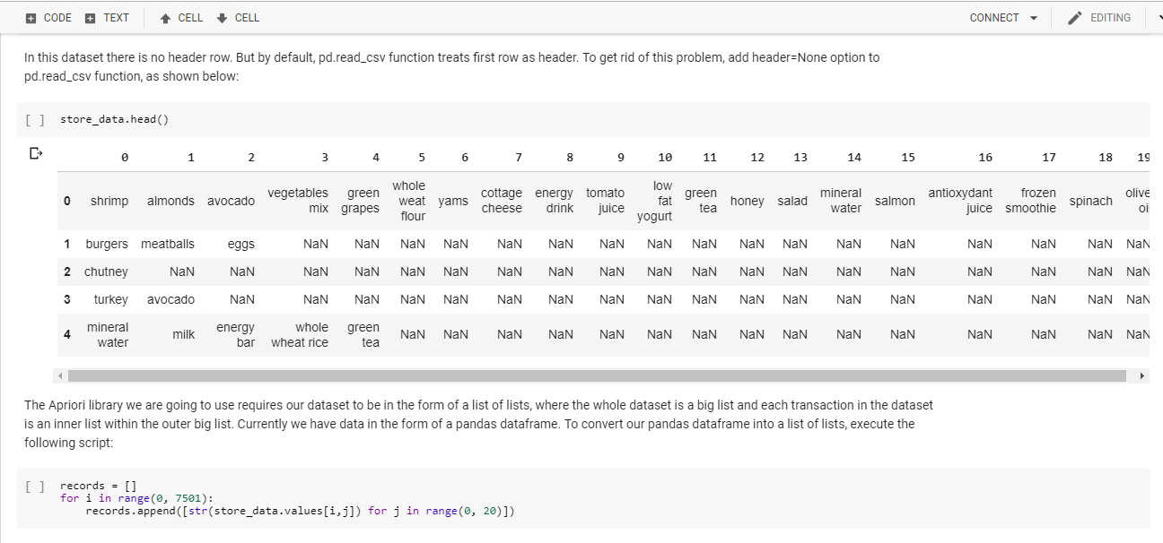

Slide 17
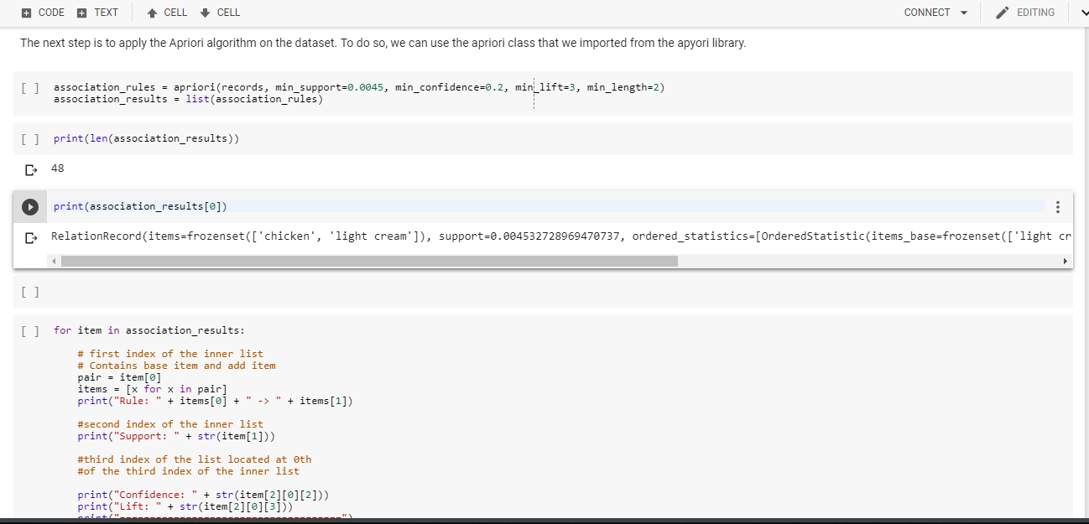

Slide 18
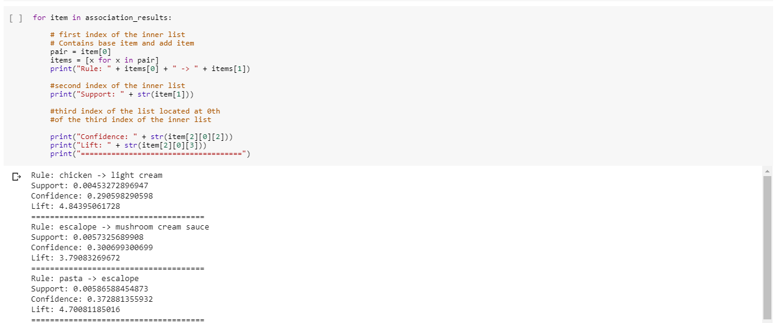

Slide 19
